Slide 2
WHAT IS JUSTICE REINVESTMENT?
Justice reinvestment is a way of reducing Aboriginal incarceration, by implementing strategies that address the drivers into the criminal justice system, led by the community and informed by data.
These strategies contribute to broader systemic reform in education, health, care, and child protection.

Slide 3
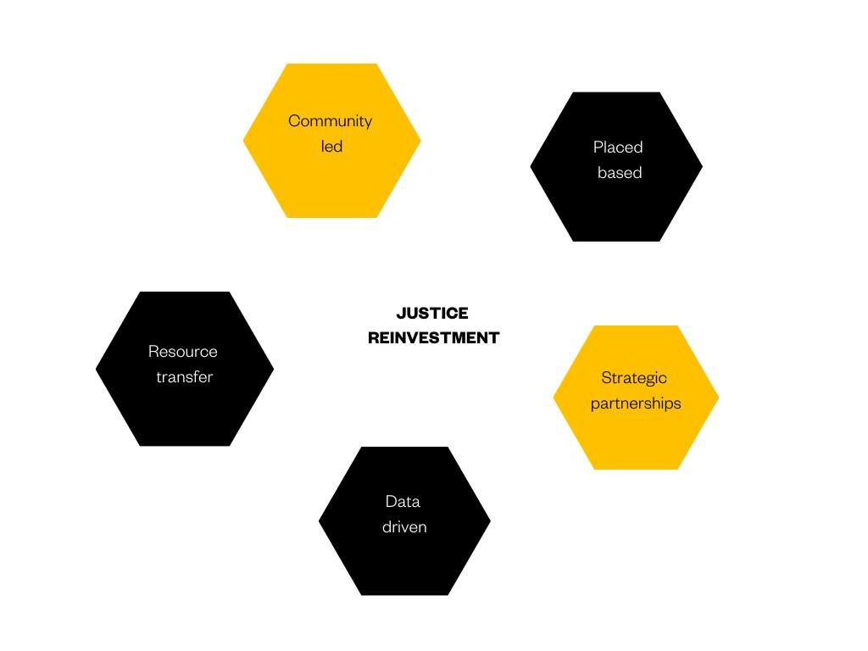
THE JR FRAMEWORK
The JR NSW framework includes the following principles:
Placed based
Community led
Data driven
Strategic partnerships
Resource transfer

Slide 4
ROLE OF JUST REINVEST NSW
Our goal is to reduce Aboriginal People’s interactions with the criminal justice system.
Our approach is through both community-led initiatives and state-wide policy and legislative reform, transferring resources away from systems that harm people, towards communities with high rates of contact with the justice system.
We work alongside Aboriginal communities to support place-based, community-led and data driven approaches to inform local solutions, such as devising local ‘justice circuit-breakers’.
Our place-based approach feeds into our broader policy and advocacy work to create levers for change.
JR NSW brings together Aboriginal communities, government, agencies, philanthropic and private sector partners across political and cultural spectrums to leverage the justice reinvestment approach.

Slide 5
ROLE OF JUST REINVEST NSW
Resources are placed in the hands of the community, funding local backbone teams, capability building and governance support, alongside strategic assistance from a supporting body.

Slide 6
HOW WE OPERATE
The below graphic sets out our phased approach to place-based justice reinvestment.
PHASE 1
Site exploration and engagement
PHASE 2
Community engagement, data collection and identification of justice circuit breakers
PHASE 3
Development of community strategy
PHASE 4
Implementation of community-led strategy
PHASE 5
Incorporation with ongoing external support from JRNSW as required

Slide 7
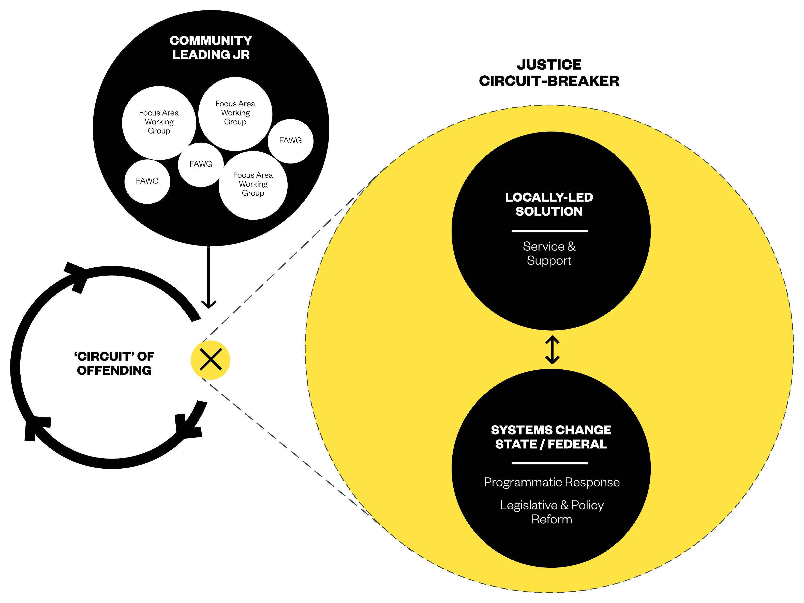
Justice circuit-breaker
Imagine you are a 12-year-old Aboriginal young person caught up in a “circuit of offending”.
You may find justice reinvestment to be the circuit-breaker you need.
Do you know a local group that identifies local solutions, and at the same time works on changing policies and legislation that effect you?
Reform is informed by data at every stage.

Slide 8
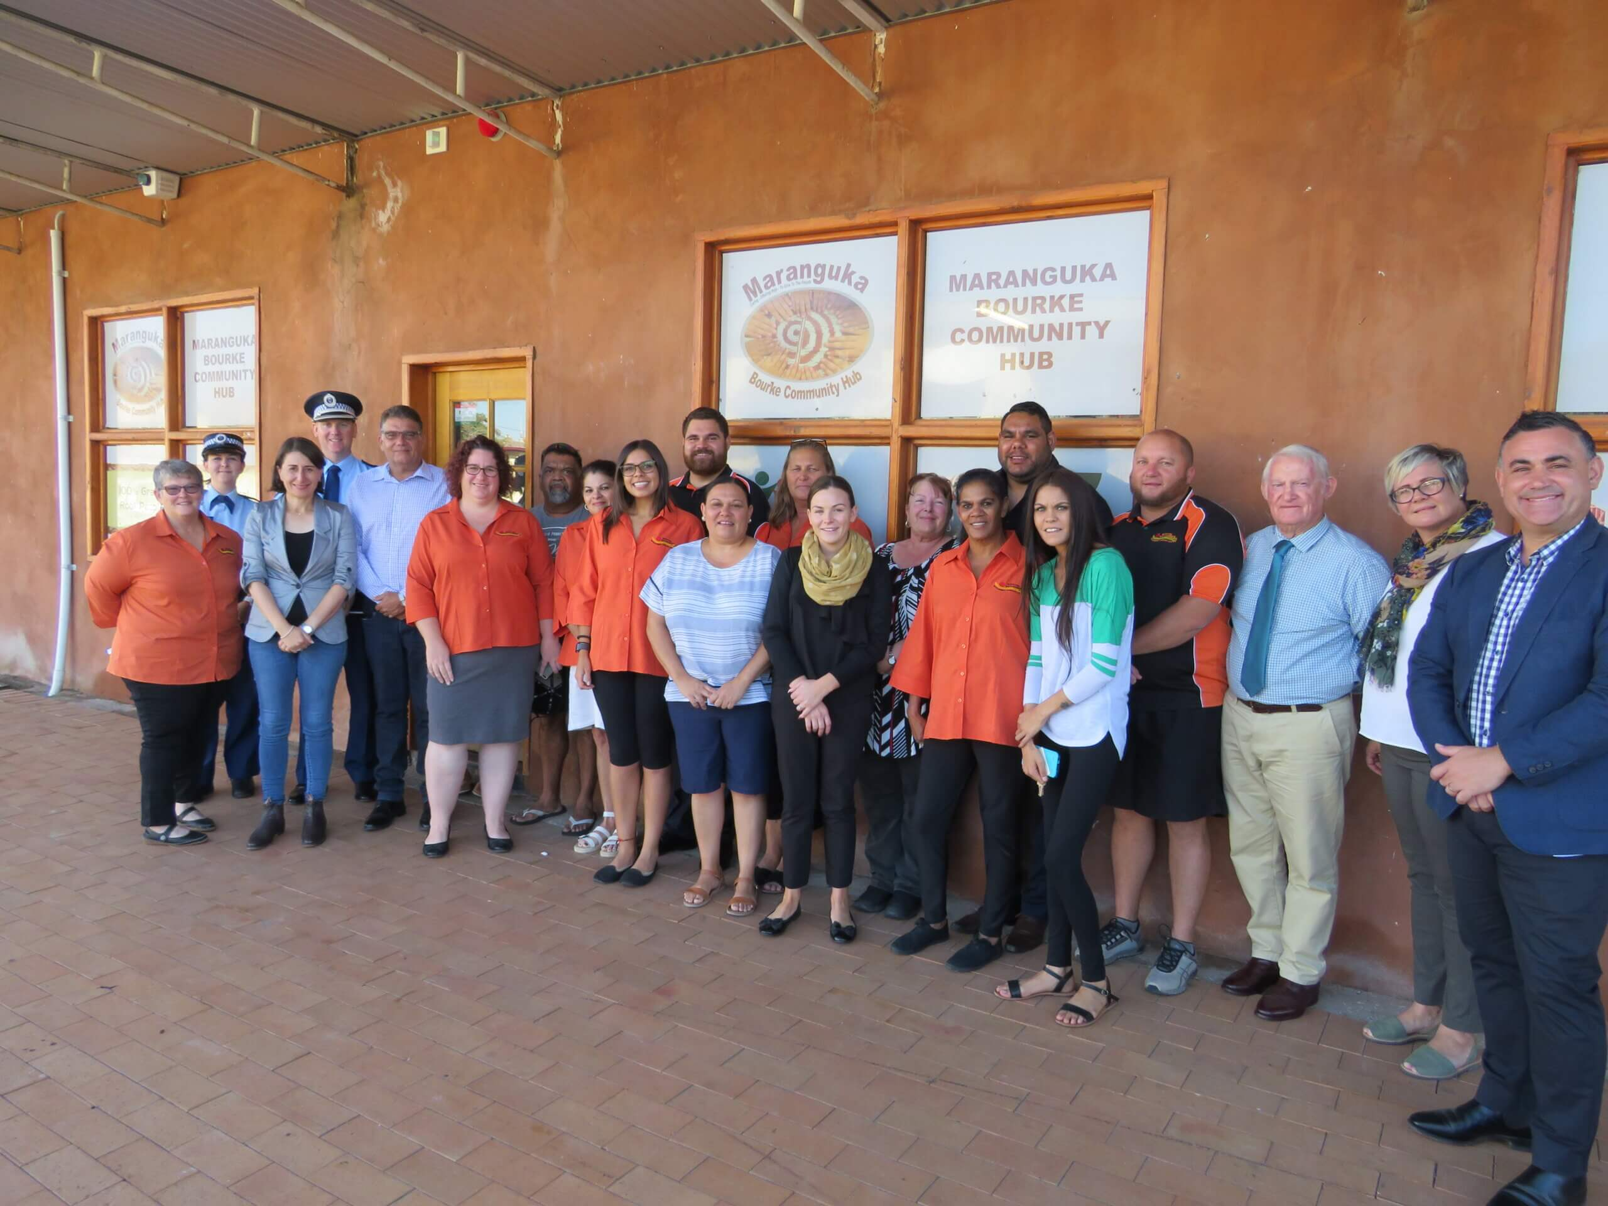
COMMUNITY-LED CHANGE
BACKBONE TEAMS
Aboriginal backbone teams coordinate the JR community-led change process, working alongside and guided by an Aboriginal leadership group in the community. These two teams are crucial for setting the right conditions for change. They jointly identify solutions to overincarceration or recidivism in their community, using a strengths-based approach.
They facilitate collective decision making about resource allocation or around setting community goals and outcomes. The aim is to create a whole-of-community movement around justice reinvestment. A diverse group of community members can participate in community-led change, including young people with lived experience of the criminal justice system.
Other activities include supporting community to access bureaucratic data, building partnerships between community and government and improving accountability of service providers.

Slide 9
COMMUNITY-LED CHANGE
COMMUNITY PARTNERSHIPS
Community Partnerships is an essential function of JR NSW that prioritises engagement with Aboriginal communities across New South Wales. These partnerships ensure opportunities to explore whether a JR approach is right for them and assisting a community in developing local JR leadership and processes. This involves building an understanding of JR in the community, supporting local capability and leadership development, and supporting collaboration and data-driven decision-making in potential JR sites.
YOUTH ENGAGEMENT
Just Reinvest NSW aims to elevate the voices of Aboriginal young people and support them to advocate for systems change in their own communities and on a state level. By building relationships with young people, especially young people who have been harmed by multiple systems, and providing them with support, resources, skills and opportunities to participate in decision-making, JR NSW builds a platform for young leaders in communities who are engaging in justice reinvestment initiatives. Their activities can be witnessed on the community pages of this website, including Mounty Yarns in Mt Druitt and the Youth Forum in Moree.

Slide 10
Community readiness
Is your community ready to explore a JR approach? The need for change in your community could be in relation to:
Aboriginal people’s contact with the criminal justice system
The rates of Aboriginal children and young people in out of home care
Students being suspended from school and disengaging
Persistent economic and social disadvantage, and/or Communities’ experience that the delivery of services in their communities is failing.

Slide 11
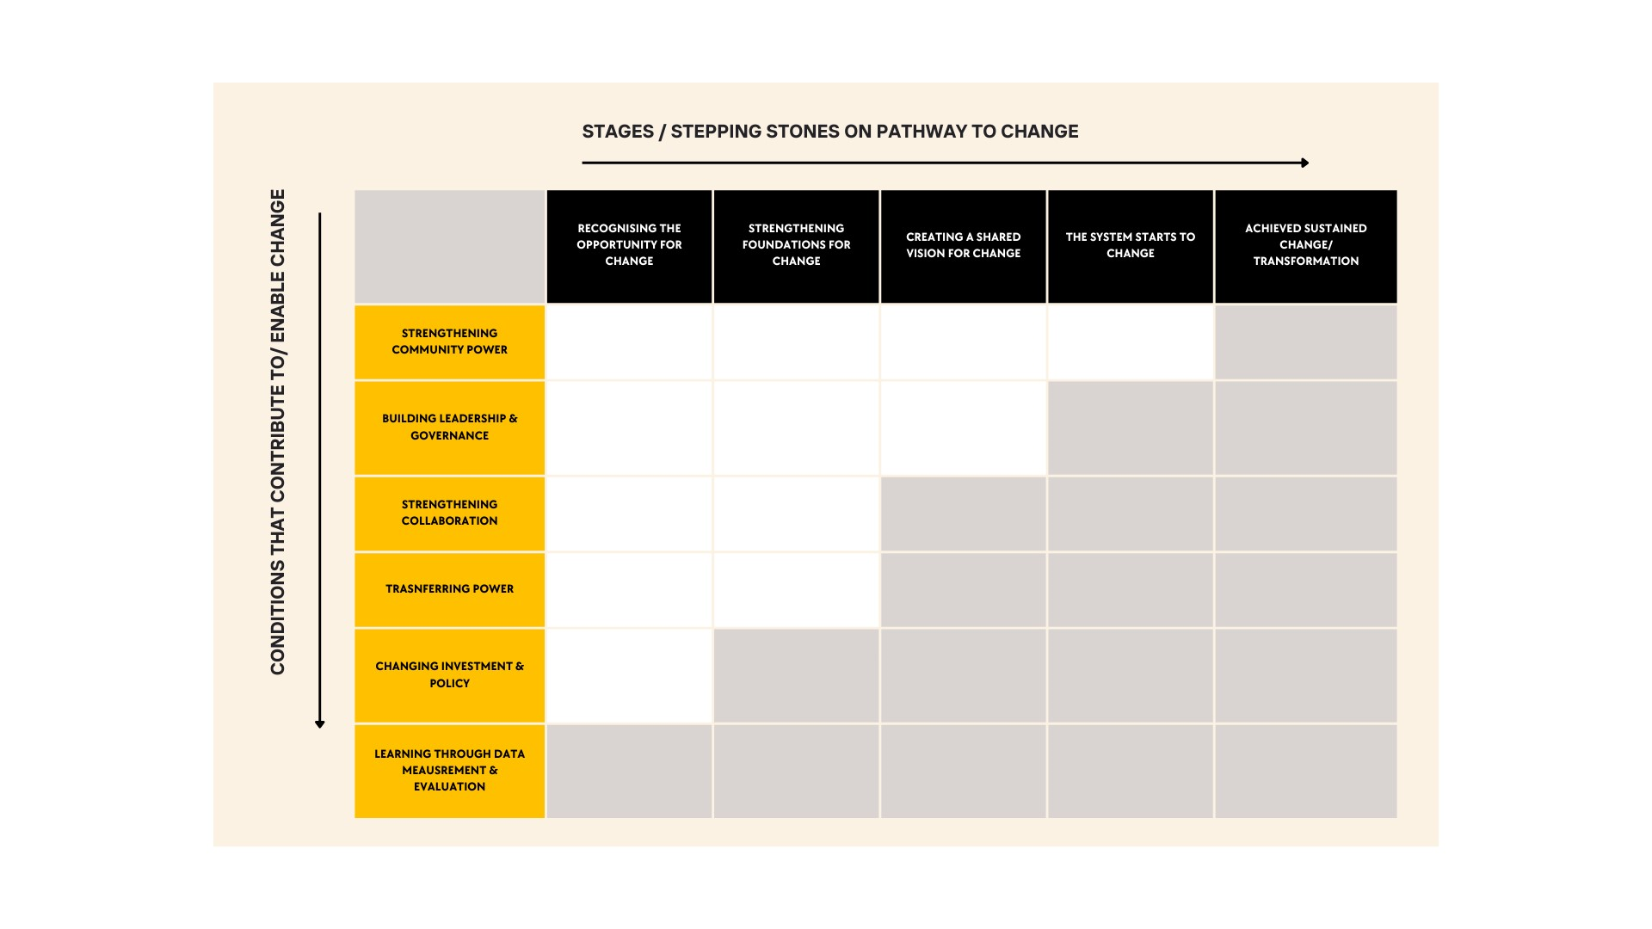
JR PATHWAY TO CHANGE

Slide 12
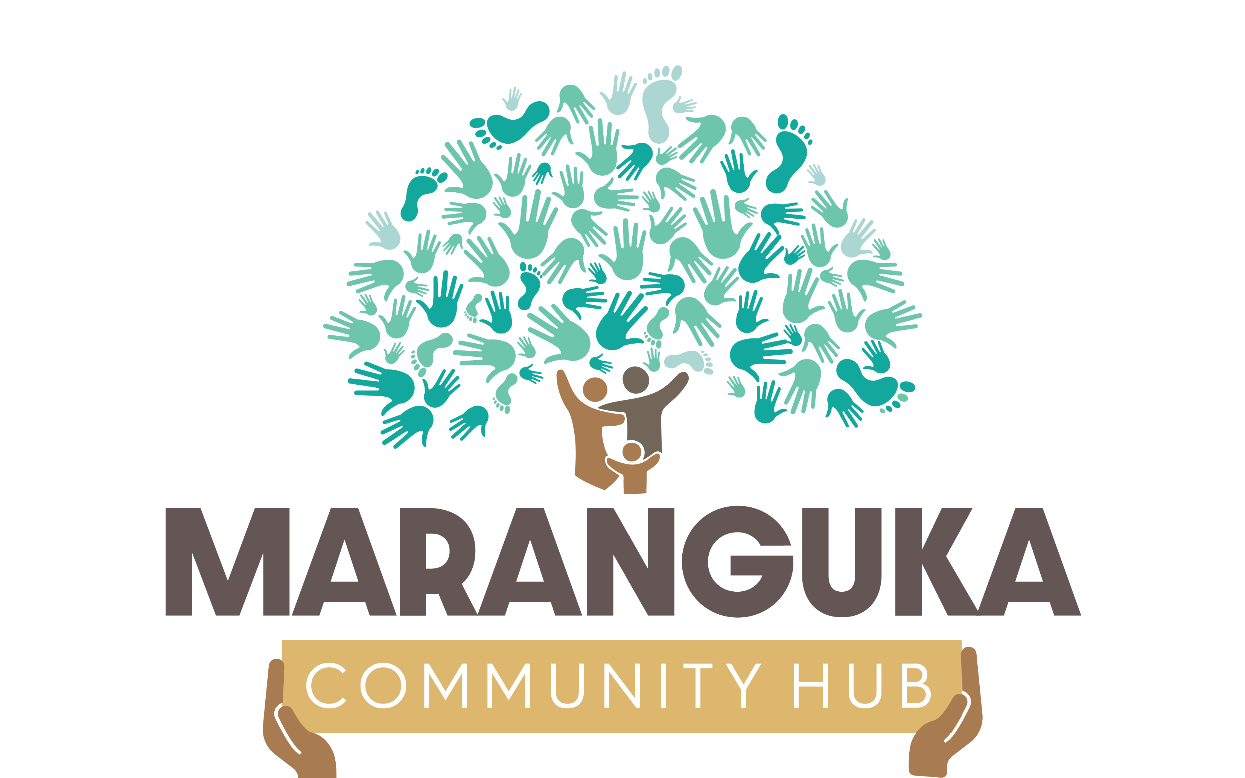
A JR JOURNEY TO INDEPENDENCE
Phase 1 JR NSW partners with a community to propose a plan for justice reinvestment initiative. A local JR Backbone Team is installed.
Phase 2 Data collection and system is agreed with local services. An Aboriginal Leadership Group is formed with the authority to convene a JR strategy.
Phase 3 A cross sector leadership group is formed with the Aboriginal Leadership Group and JR backbone team, and together finalise the strategy, and establish Focus Area Working Groups.
Phase 4 Funding is secured to begin implementation phase. Following successful pilot and evaluation, sustainable funding agreements are reached with funders.
Phase 5 Local JR entity is formed and legally becomes an independent organisation controlled and administered by the local Aboriginal community and separate from JR NSW administration.

Slide 13
JR NSW COMMUNITIES
BOURKE - MARANGUKA
2013 The Maranguka Community Hub was opened. JR NSW partnered with Maranguka to propose a plan for the first major justice reinvestment pilot site in Australia.
2014 Data request made to NSW Government to begin data collection within the community. The Bourke Tribal Council was officially formed, bringing together members from 24 tribes.
2015 Bourke Tribal Council initiates ‘Growing Our Kids Up Smart and Strong’ strategy and Working Groups are established.
2016 Maranguka secures 3-year funding from philanthropy to begin implementation phase.
2017 Maranguka advaoctaed for family violence services to come to Bourke, which launched the Gawimara Burrany Ngurung “Picking Up the Pieces” program. The first “Healthy Kids Bus Stop was held in Bourke, from which 32 children require referral.

Slide 14
JR NSW COMMUNITIES
BOURKE – MARANGUKA cont’d.
2018 KPMG produced an impact assessment of Maranguka. The Men’s Space opened and Men of Bourke hub was created. SOS Youth worker role started following Maranguka Youth Advisory Council advocacy.
2019 The Commonwealth and NSW Governments announced funding to support ongoing implementation as part of Stronger Places, Stronger People initiative. Maranguka Education Employment & Training Community Summit was held. Collaboration Agreement workshop held with services and agencies in Bourke to address factors for reduction in family and domestic violence.
2020 Maranguka conducted a Summer School Holiday Program for the youth of Bourke. Maranguka’s Early Childhood & Parenting Group partnered with Connected Beginnings to better achieve goals. Inaugural welcome Baby to country held.
2021 Collaboration Agreement formalised for family and domestic violence services and community. The Maranguka - Wellness Connect Mental Health Summit was held in Bourke with Regional Health Minister in attendance.

Slide 15
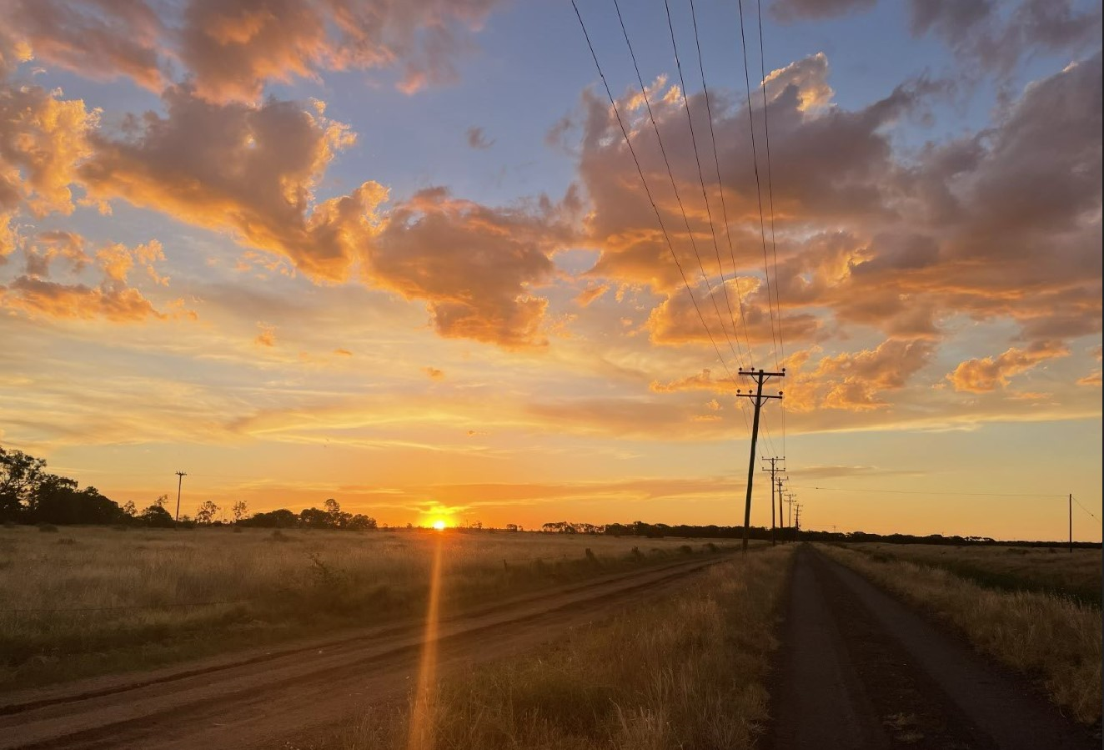
JR NSW COMMUNITIES
JR Moree
Backbone team (4 staff)
Community Leading JR
Aboriginal Leadership Group
Youth Engagement
Youth Bail Project
Saturday Night Program
Youth Forum
Education Summit

Slide 16
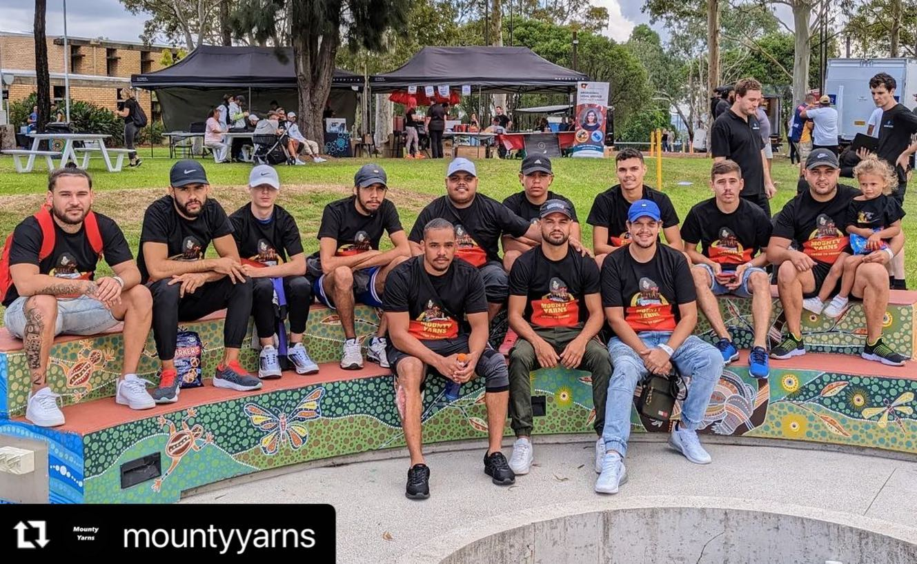
JR NSW COMMUNITIES
JR Mt Druitt
Backbone Team (5 staff)
Youth Engagement
Mounty Yarns
Learner Drivers Program
Youth Bail Project

Slide 17
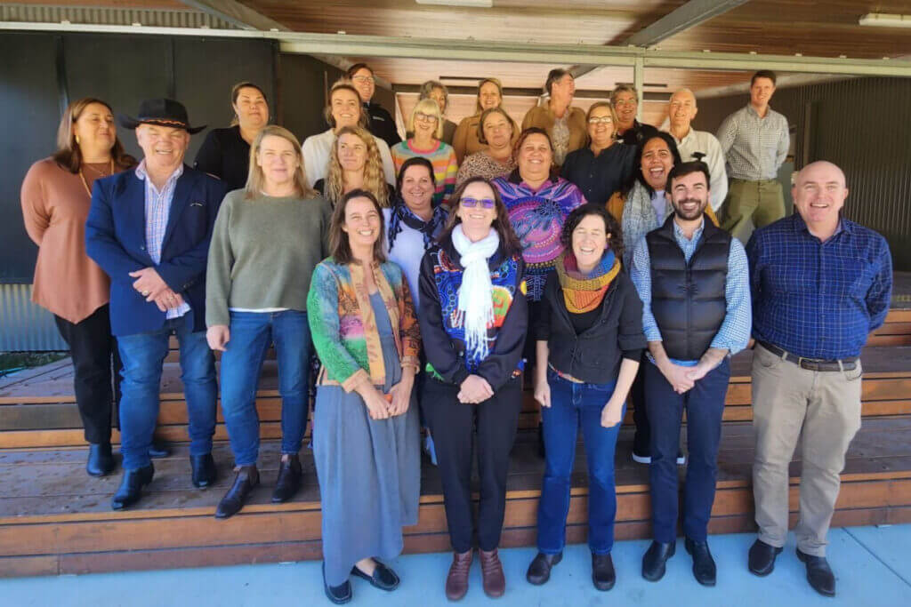
JR NSW COMMUNITIES
Kempsey ‘Learning the Macleay’
Backbone Team
Stronger Places, Stronger People
Kinchela Boys Home Aboriginal Corporation
Community media team
Data analysis
Police relations
Justice circuit-breakers

Slide 18
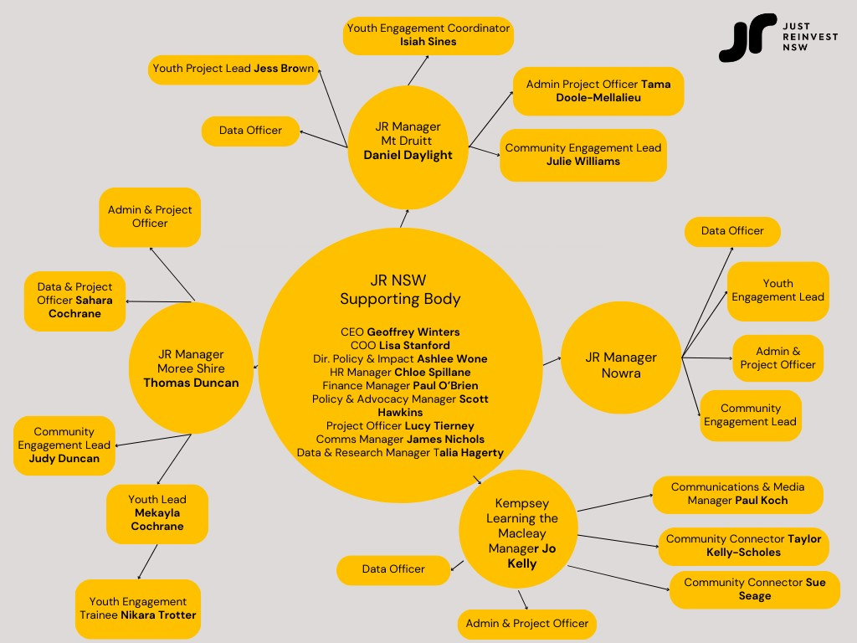
TEAM

Slide 19
SUPPORTING BODY - REDFERN
Geoffrey Winters, CEO
Lisa Stanford, COO
Ashlee Wone, Director of Policy & Impact
Scott Hawkins, Manager of Policy & Advocacy
Lucy Tierney, Strategic Projects Lead
James Nichols, Communications Manager
Talia Hagerty, Manager Data & Research
Chloe Spillane, HR Consultant

Slide 20
POLICY & IMPACT
To bring about long-term systemic change, the JR NSW policy and impact agenda is to bring community voices and community-led solutions to disrupt the ‘pipeline to prison’ by advocating for early intervention, prevention and diversion from the criminal justice system, and for further reform in the system.
We:
Amplify community voices and support community to develop solutions.
Build relationships with key federal and state government officials and public servants who do and may influence justice and Indigenous affairs laws and policy.
Raise Awareness of Justice Reinvestment and educate government leaders and public servants to build and strengthen support for community-led solutions and drive collaboration and reform.
Grow and strengthen partnerships, networks and alliances to test and deliver the JR NSW policy agenda.

Slide 21
DATA & MEL
Working with data is one of the key elements of the JR approach and remains an important indicator of identified priority JR goals and outcomes. Determining what type of data is relevant to evaluating progress against these goals and outcomes is challenging and has serious implications for service delivery and financing.
Using Indigenous Data Sovereignty (IDS) and Indigenous Data Governance (IDG) Principles, Aboriginal communities have difficulties in accessing government data to inform their JR work.
“Data is storytelling, truth telling and power. Collecting and using stories, truth and power supports communities to see what needs to change and how to change it. This is self-determination. Placing the authority in the hands of the community.
Data from government generally measures what is being funded, it’s impact and specific social indicators to be addressed by government departments. It can tell us what is going on more broadly.”
Ashlee Wone, Director of Policy & Impact, JR NSW

Slide 22
DATA & MEL
Data is crucial for Aboriginal communities in defining goals and outcomes because when they’re involved in how and what data will be used to measure this, they will have a sense of ownership of their work with JR.
When set out in monitoring evaluation and learning frameworks, Aboriginal communities can have a structured and directed approach that guides this work, but also seeks commitment from government to have the same community-guided goals, outcomes, and measurement. In the absence of this, important cultural and community perspectives are denied in government ways of working.
“Data from community showcases experience of people in that community. It can tell us why something is happening and how it affects individuals and community groups. Communities need both to design and drive community-led solutions.” – Ashlee Wone, Director of Policy & Impact. JR NSW

Slide 23
CONTACT US
WEBSITE: www.justreinvest.org.au
GENERAL ENQUIRIES: info@justreinvest.org.au
HR ENQUIRIES: hr@justreinvest.org.au
COMMUNITY ENQUIRIES: Ashlee Wone, Director Policy & Impact, ashlee@justreinvest.org.au
MEDIA ENQUIRIES: James Nichols, Communications Manager, james@justreinvest.org.au

